Slide 1


Don’t Reinvent Another Wheel (if you don’t have to)
Why Use PowerShell Modules – David Stein

Slide 2

Sponsors
~~ Place Holder ~~

Slide 3

whoami
(just pretend to pay attention and he’ll move on)
I live in Virginia Beach, VA / wife / 4 kids / 2 dogs / 1 cat
Consultant @ Catapult Systems - Austin, TX
EUD mgt (SCCM/MDT/Intune), AD/AAD, O365, Azure, SQL, Scripting
Social Stuff:
Twitter: @skatterbrainzz ← Best way to reach me
Blog: https://skatterbrainz.wordpress.com
GitHub: @Skatterbrainz

Slide 4
whoamyou
Raise Your Hand if You Have ever…
Installed and used a PowerShell Module?
(You probably have, and didn’t know it)
Written your own PowerShell Module?
Have a GitHub account?
Use Visual Studio Code (or Visual Studio)?
Found a word that rhymes with ‘module’?
Wondered if I really look like a Martian?

Slide 5


PowerShell Modules / Session Overview
What this Session will be about:
High-level view of PowerShell modules
How to find the right modules
When to use modules
Knowing when to Install vs Create
What this Session will NOT be about:
Detailed view of PowerShell Modules
Module development techniques
Words that rhyme with module
Modules

Slide 6



PowerShell Modules: Level 100
Super Brainiac mind-melting stuff (invents new martial arts)
Creating modules (pebble-snatcher)
We are Here
Understanding of Modules (enter the temple)

Slide 7
PowerShell Saturday – Related Sessions
Using DbaTools to Automate Database Migrations – Joshua Corrick
Crossing the Divide – A System Administrator’s Path to DevOps – Dave Carroll
Search Event Logs Like a Boss – Phil Bossman
Code. Commit. Deploy. Starting your 3 step journey to utilizing Pipelines – Stephen Valdinger

Slide 8
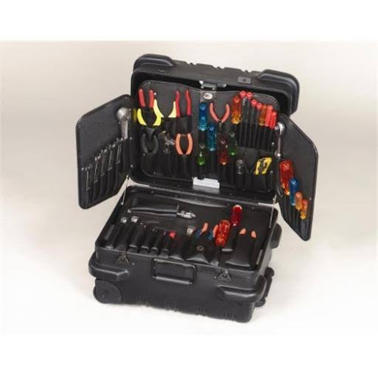

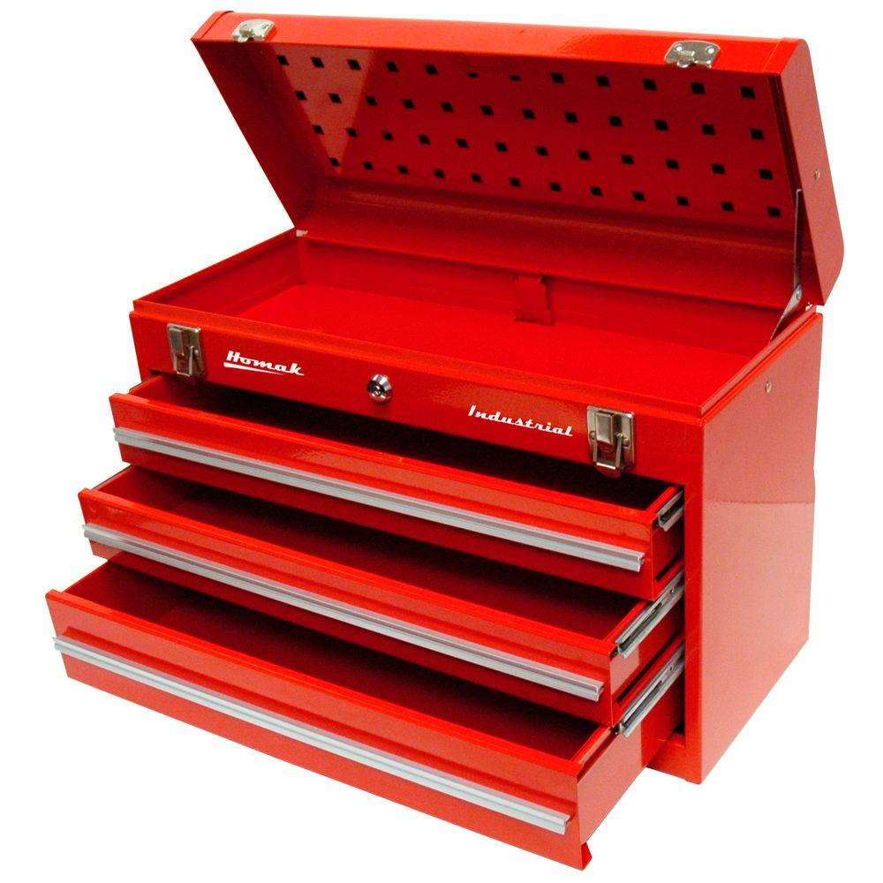
PowerShell Modules are Toolboxes with Tools
Module
Module
Module
Functions
Functions
Functions
Automotive
Electrical
Networking

Slide 9

A PowerShell Module is a Tool
(Tool, the band)

Slide 10
PowerShell Modules: Access to the World
Exchange/EOL
Docker
Chocolatey
MicrosoftGraph
ActiveDirectory
Intune
Slack
ServiceNow
CosmosDB
Azure
SharePoint/SPOL
Office
Office365
GoogleCloud
VSTS
Jira
OneDrive
PowerShell
REST
IIS
AzureAD
Your-Module
Windows
DNS
AWS
JSON
INI
Kubernetes
SQLServer
GitHub
ConfigMgr
PowerBI
SystemCenter
Linux
DFS
Facebook
VMware
Hyper-V
Twitter
Oracle
MicrosoftTeams
AzureStack
WindowsInstaller
DHCP
XML

Slide 11
PowerShell Modules as Building Blocks
Module1
Module3
Module
Module2
Module4
MyModule.psd1
Module5
Module6
RequiredModules = @(“module1”,”module2”…)

Slide 12
PowerShell Module Commands
Module Related Commands | Purpose
Find-Module | Searches for a module in a repository
Get-Module | Lists installed modules (e.g. Get-Module–ListAvailable)
Import-Module | Imports an installed module to current session
Remove-Module | Unloads an installed (imported) module from the current session
Install-Module | Installs a module from a repository
Uninstall-Module | Uninstalls an installed module from the local machine (or user context)
Update-Module | Installs latest version (if a newer version exists)

Slide 13
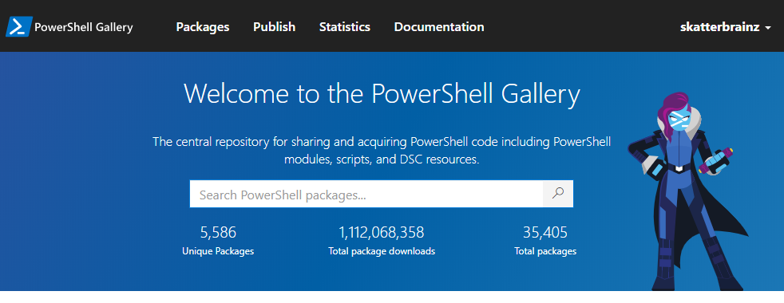
Finding PowerShell Modules
Use Find-Module
Search PowerShellGallery.com
C:\> Find-Module dbatools
https://www.powershellgallery.com

Slide 14

Finding PowerShell Modules
DEMO TIME
Module

Slide 15

Where Do Modules Get Installed?
DEMO TIME
Module
Module

Slide 16
PowerShell Module Installation Path
C:\> $env:PSModulePath
C:\Users\jsmith\Documents\WindowsPowerShell\Modules;C:\Program Files\WindowsPowerShell\Modules;C:\WINDOWS\system32\WindowsPowerShell\v1.0\Modules;C:\Program Files (x86)\Microsoft Azure Information Protection\Powershell
C:\> $env:PSModulePath –split ‘;’
C:\Users\jsmith\Documents\WindowsPowerShell\Modules
C:\Program Files\WindowsPowerShell\Modules
C:\WINDOWS\system32\WindowsPowerShell\v1.0\Modules
C:\Program Files (x86)\Microsoft Azure Information Protection\PowerShell

Slide 17
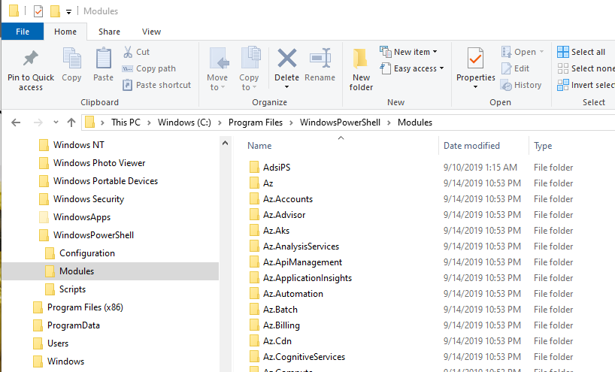
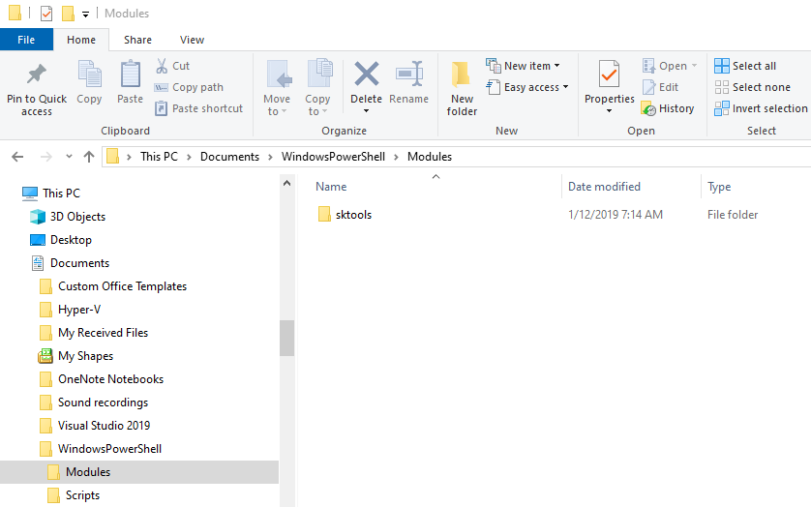
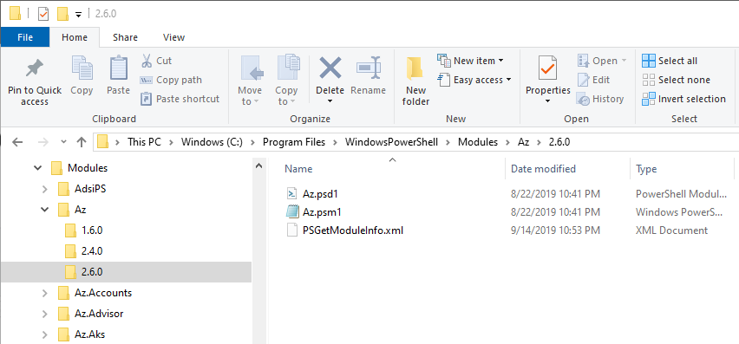
PowerShell Module Installations

Slide 18

Imaginary Pretend Scenarios
Modify Permissions on a Folder (Carbon)
Read from a SQL Server Database (DbaTools)
Read from an Excel spreadsheet (ImportExcel)
Check for and Install Updates (PSWindowsUpdate)
Rendering Data to Web Pages (ud-cmwt)
DEMO TIME
Module

Slide 19
PowerShell Modules: Strategies
Your Script
Your Script
Your Script
A
B
C
Your Script
Other Module
Your Module
Your Script
Other Module
Your Script
Other Module
Other Module
All work is done by your own scripts
Work is done by your own script using public modules
Other Module
Work is done by your own script using a mix of your modules and public modules

Slide 20
PowerShell Modules: Demo 3.1
Modify Folder Permissions using Carbon
$folder = “c:\TestFolder”; $group = “users”
Grant-CPermission $folder –Identity $group –Permission Full `
–ApplyTo ContainerAndChildContainersAndChildLeaves –Type Allow
See also: https://blog.netwrix.com/2018/04/18/how-to-manage-file-system-acls-with-powershell-scripts/

Slide 21
PowerShell Modules: Demo 3.2
Get Results from Database Query using DbaTools
$server = “db123”
$db = “inventory”
$query = “select distinct name from workstations where dept=5”
$names = Invoke-DbaQuery –SqlInstance $server –Database $db –Query $query

Slide 22
PowerShell Modules: Demo 3.3
Get Data from an Excel Spreadsheet using ImportExcel
$filepath = “c:\files\computers.xlsx”
$wksh = “laptops”
$lt = Import-Excel –Path $filepath –WorksheetName “Laptops”
$names = (Import-Excel –Path $filepath –WorksheetName $wksh).Name
Watch the YouTube video by David Finke: https://youtu.be/fvKKdIzJCws

Slide 23
PowerShell Modules: Demo 3.4
Check for Updates / Install Updates using PSWindowsUpdate
Get-WindowsUpdate –AcceptAll –Install –WindowsUpdate -IgnoreReboot
Watch the YouTube video by David Finke: https://youtu.be/fvKKdIzJCws

Slide 24
PowerShell Modules: Demo 3.5
Get Computers from AD Security Group (ActiveDirectory, AdsiPS)
$names = (Get-ADGroupMember –Identity “sales workstations”).Name
Figure 3 - Example using ActiveDirectory module
$names = (Get-AdsiGroupMember –Identity “sales workstations”).Name
Figure 4 - Example using AdsiPS module

Slide 25
PowerShell Modules – Popular Selections
Module | Description
Carbon | Automating the configuration Windows 7, 8, 2008, and 2012 and automation the installation and configuration of Windows applications, websites, and services
DbaTools | The community module that enables SQL Server Pros to automate database development and server administration
PSWindowsUpdate | Manage the Windows Update client
OSDBuilder | OS image customization, patching and preparation for use in automating image processes
Posh365 | Connect. Migrate. Maintain. A toolbox for cloud and hybrid environments
PlatyPS | Automate markdown file generation from PowerShell module comments
ActiveDirectory, AdsiPS | Query and manipulate Active Directory objects and configuration settings

Slide 26

What if you need to make a module?
Module

Slide 27
When a Module Might be Better
Toolbox
Get-PoUsers.ps1
Param (
[parameter(Mandatory)]
[int] $Dept
)
try {..}
catch {..}
Param ()
try {..}
catch {..}
Get-PoUsers
Get-PoDepartments
Get-PoList
Get-PoCategories
Param (
[parameter(Mandatory)]
[int] $Dept
)
try {..}
catch {..}
Purchase Order
System
Tool
(One Script)
C:\> .\Get-PoUsers.ps1 –Dept 4
C:\> .\Get-PoDepartments.ps1
C:\> .\Get-PoList.ps1 –Type Rejected
C:\> .\Get-PoUsers.ps1 –Dept 4

Slide 28
PowerShell Module Construction
PoSystem.psm1
(.ps1 files)
PoSystem.psd1
A
Get-ChildItem $PSScriptRoot -Recurse | %{ . $_.FullName}
Param ( . . .
Param (
[parameter(Mandatory)]
[int] $Dept
)
Try {..}
Catch {..}
@{
RootModule = ‘.\PoSystem.psm1’
GUID = ‘234098ab-1334-3445-…’
Author = ‘Freddie Mercury’
ModuleVersion = ‘1.0.0’
Description = ‘…’
FunctionsToExport = @(..)
…
…
}
Function Get-PoUsers {..}
Function Get-PoUsers {
Param (
[parameter(Mandatory)]
[int] $Dept
)
Try {..}
Catch {..}
}
PoSystem.psm1
Function Get-PoUsers {..}
Function Get-PoDepartments {..}
Function Get-PoList {..}
(manifest)
B
C:\> Import-Module PoSystem
C:\> Get-PoUsers –Dept 4
C:\> Get-PoDepartments
C:\> Get-PoList –Type Rejected

Slide 29



PowerShell Modules: Best Practices
Step 1
Step 2
Step 3
Get it Working!
Add Comments
Clean Up!
Verify Results
Script Comments
Function Comments
Code Comments
Refactor
Refactor some more
Keep Refactoring

Slide 30
Sponsors
~~ Place Holder ~~

Slide 31
Learn More!
User Groups !! (tip: Meetup.com)
Twitter! Follow the speakers (and who we follow)
Pluralsight courses
Books: PS Conference Book (LeanPub), MEAP
Twitch: Chrissie, Mark E. Kraus
PowerShell.org

Slide 32
Questions?

Slide 33
Thank you!

